Slide 1


Assisting 500+ New Female Founder Startups in Queensland Australia by 2032
Find Out More Here, Then Become A Founder.
Presented By:
Luke Catalyst Nathan Hayes
Disclaimer: All 100+ Start-ups will have female CEOs, plus have majority female executive. All other genders are welcome.

Slide 2



Brisbane City,
Queensland.
1: World Leading Ecosystems
2: Worlds Biggest Moonshots
3: Worlds Most Trustworthy AI
4: Worlds Biggest Box Office Hits
5: Worlds 1st Autonomously Built City

Slide 3
Start-up Timeline
Start-up
Always Open
Company Registrations
Project Development
Momentum
Govt. Grant Applications
Private Investor Pitches
Cascade
Work Smart Ecosystem
Prototype, Launch, Feedback
Intermission
Next Gen
Prepare for Rapid Hiring
Scale-up, Go Global
Product Market Fit
Media Frenzy

Slide 4
Long View Timeline: 4 years
Start-up
2021 Beginning.
Company Registrations
Project Development
Momentum
2022
Community Development
Project Evolution
Cascade
2023
Global Decentralization
Moonshot Majesty
Intermission
Next Gen
Live Aid 2025
Artistic World Referendum
A New Beginning
2024
Mergers & Acquisitions
Projected Exit & Pivot

Slide 5

World Leading Ecosystems
Start-up Fluently, Sustain the Momentum, Flow-on Cascade and Next Generations.

Slide 6
Worlds Biggest Moonshots
Dream BIG. Grow Them BIGGER.
Scale Up 1st Principals Thinking.

Slide 7
Worlds Most Trustworthy AI
Aura of Intelligence in a Global Association for Joyful Responsible Abundance on Earth. #AuraOfIntelligence #GAJRAearth

Slide 8
Worlds Biggest Box Office Hit
Galactic Climate Change and The Dark Energy Wave Will Now Face Humanity. #aTimelessLand #CrystalCitiesOfOz

Slide 9
Worlds 1st Autonomously Built City
A Crystal City Underneath Moreton Bay Marine Park A.K.A. Quandamooka Country. #10MillionPeople #SafeFromExtinction

Slide 10
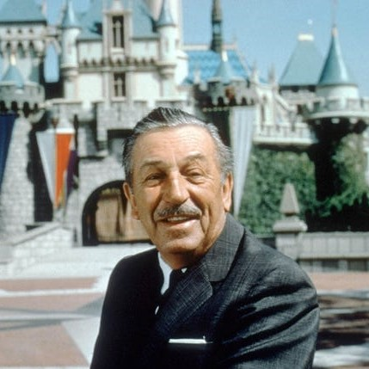
The way to get started is to quit talking and begin doing.
Walt Disney

Slide 11

BYO Investment or Seek Funding via Collaboration. The Future Is Anyone's To Create If They Dare to Act!
Luke Hayes

Slide 12
Start-up Themes
If you haven’t a BIG idea, Not a problem. Here are The Biggest and Best Themes to Brainstorm:
Simulations & Robots
Nano-Fabrication
Speed of Transition
Health, Wealth and Wisdom.
Travel, Tourism and Migration.
Joyful Responsible Abundance.
Autonomous Essential Services.
Jobs and Intermittent Retirement.
Microchips, Sensors and Memory.
On Demand Production.
Microbiome and Microfluidics.
Recycling and Remediation.
Extreme Environment Metamaterials.
Storytelling.
Governance.
Market Analysis.
Succession Planning.
Environmental Monitoring.
Want a head start? Show your interest to me for my ready planned, narrative integrated systems.

Slide 13

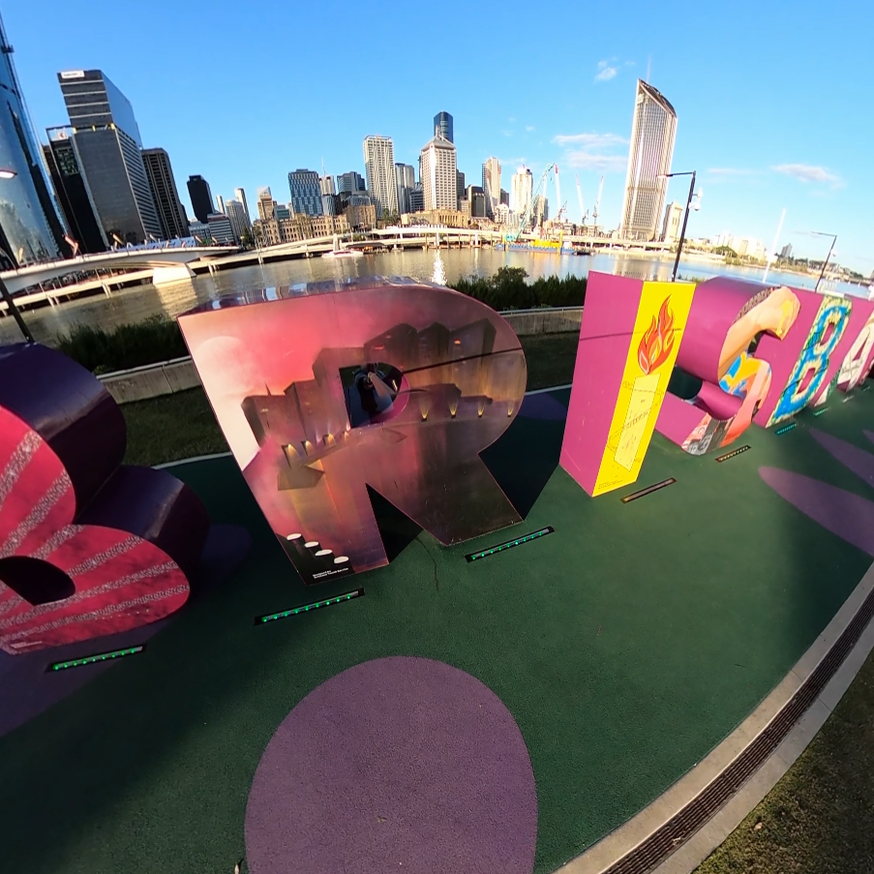

At Many Venues to Showcase Brisbane to the World.
Assisted Company Registration
Sponsored Weekly Meetups
Just-In-Time Content Delivery
Sponsored In-Kind Services
Local Legends Introductions
Global Legends Virtual Meetings

Slide 14
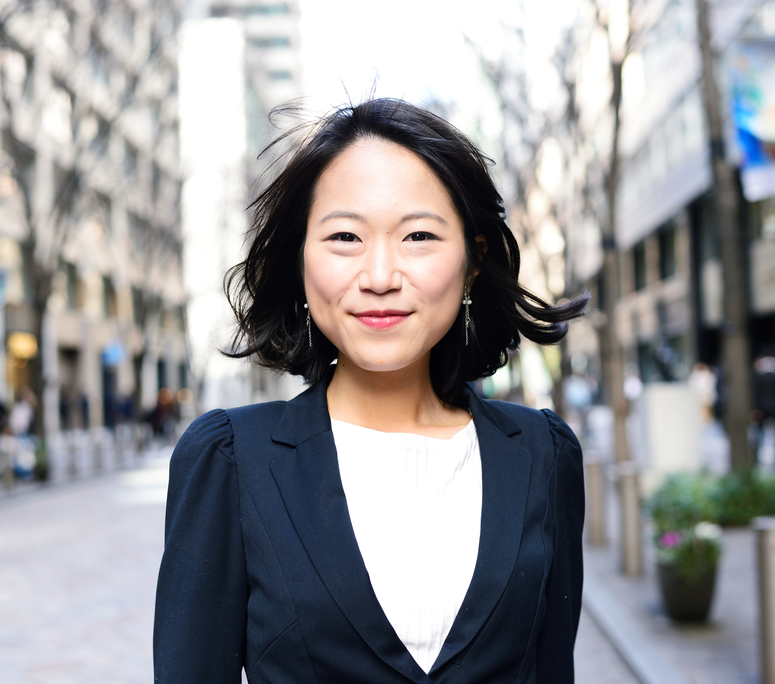


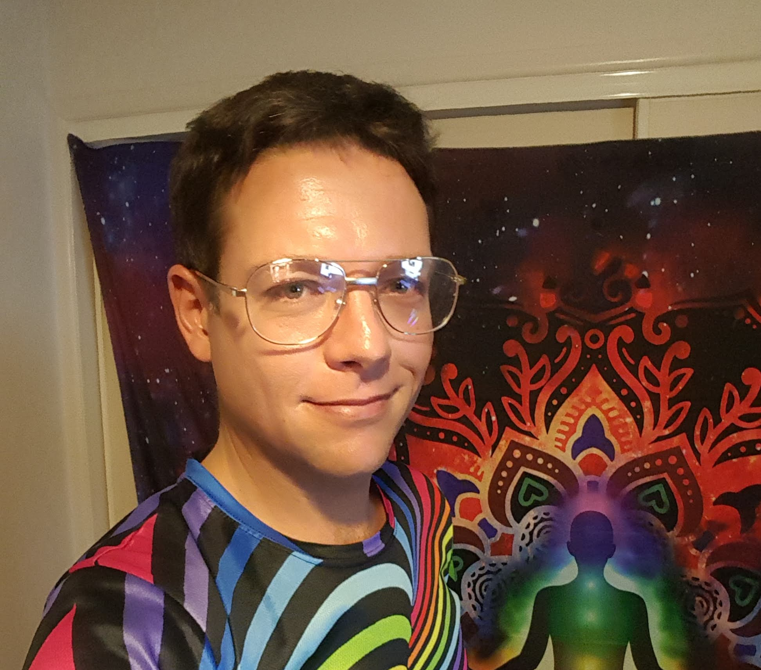
Founding Team Matchmaker:
Don’t have a team? Not a problem. Meet potential Co-Founder matches every Sunday.
Stock Image
Stock Image
Stock Image
Real Image
Who is?
Who is?
Who is?
Luke Hayes
CEO/COO
CFO/CMO
CTO/CIO
Non-Executive Director
Already have a team or almost there? Register now for the 1st Meetup!

Slide 15

Believe It,
Become It.
Are You In?
I dare to believe this will become the most successful start-up ecosystem in the history of modern human civilisation as all participants master honest communication and the principal virtues of hope, empathy and joyful responsible abundance.

Slide 16


Thank You
Luke Catalyst Nathan Hayes
AuraOfintelligence@gmail.com
LukeCatalyst.com

